Slide 1
printer
Made by: tamás németh

Slide 2
HISTORY
The first computer printer designed was a mechanically driven apparatus by Charles Babbage for his difference engine in the 19th century; however, his mechanical printer design was not built until 2000.
The first patented printing mechanism for applying a marking medium to a recording medium or more particularly an electrostatic inking apparatus and a method for electrostatically depositing ink on controlled areas of a receiving medium, was in 1962 by C. R. Winston, Teletype Corporation, using continuous inkjet printing. The ink was a red stamp-pad ink manufactured by Phillips Process Company of Rochester, NY under the name Clear Print. This patent (US3060429) led to the Teletype Inktronic Printer product delivered to customers in late 1966.

Slide 3
WHAT IS PRINTER?
A printer is an output device that prodcues text and graphics on paper.
Many printers are primarily used as local peripherals, and are attached by a printer cable or, in most newer printer, a USB cable to a computer which serves as a document source.
In addition, a few modern printers can directly interface to electronic media such as memory card, or to image capture devices such as digital camera.

Slide 4
TYPE OF PRINTER
Printers can be divided into two main groups, impact printer and non-impact printer.
Impact printer produces text and images when tiny wire pins on print head strike the ink ribbon by physically contacting the paper.
Non-impact printer produces text and graphics on paper without actually striking the paper.
Printers can also be categorized based on the print method or print technology.
The most popular ones are inkjet printer, laser printer, dot-matrix printer and thermal printer.

Slide 5
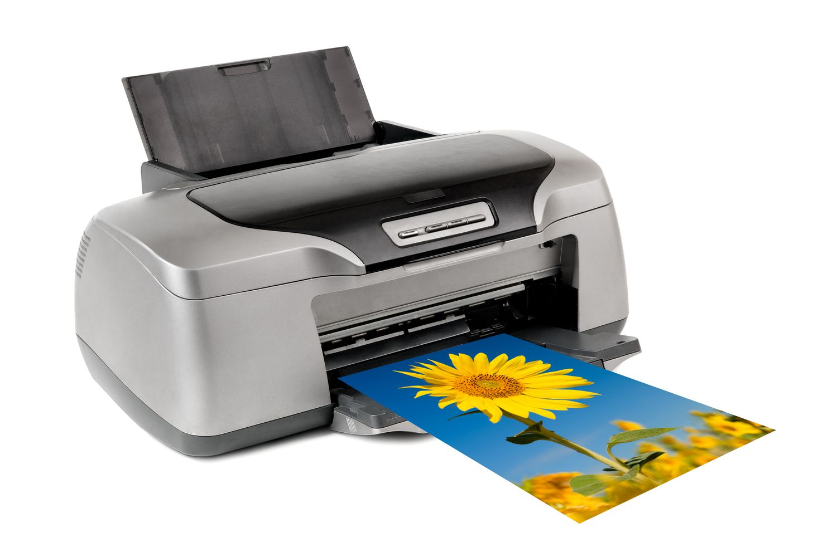
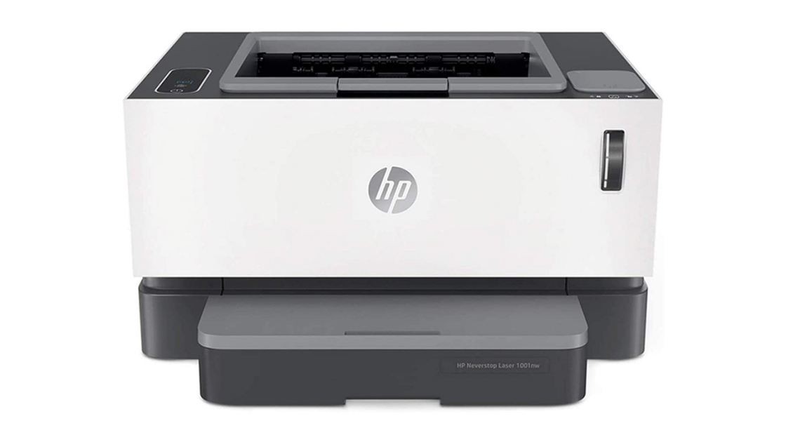
TYPE OF PRINTER
INKJET PRINTER
LASER PRINTER
An inkjet printer is a type of computer printer that reproduces a digital image by propelling variably-sized droplets of liquid material(ink) onto a page.
Destktop inkjet printers, as used in offices or at home, tend to use aqueous inks based on a mixture of water, glycol and dyes or pigments.
Laser printers are non-impact printers which can printer text and images in high speed and high quality resolution, ranging fro 600 to 1200dpi.
A laser beam projects an image of the page to be printed onto an electrically charged rotating drum coated with selenium.

Slide 6
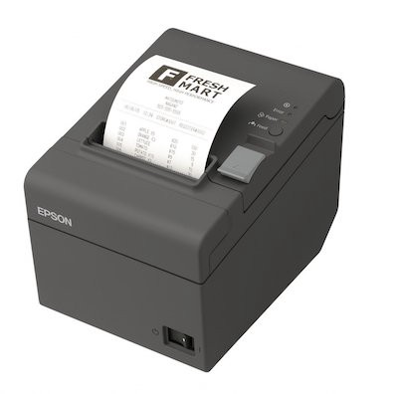
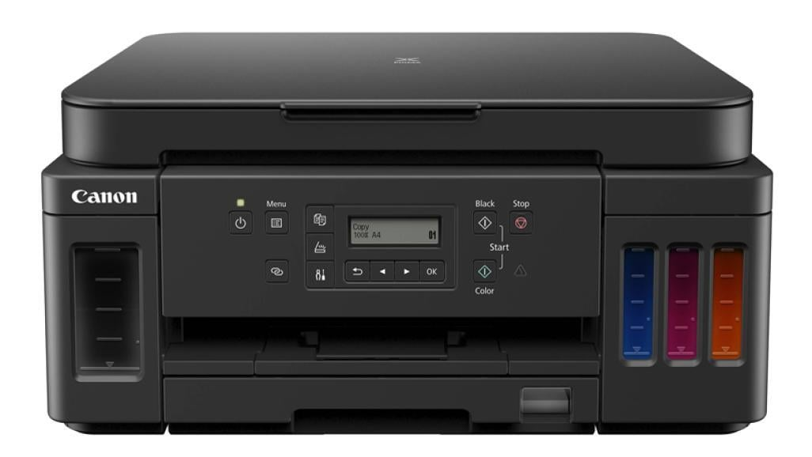
OTHER TYPE OF PRINTER
Thermal printers:
The heat activates the thermo-sensitive coloring ayer of the thermo-sensitive paper, which manifests a pattern of color change in response
Photo printers:
Are color printers that produce photo lab quality pictrues on photo paper.
All in one printers:
It is a machine that includes several functionalities including printer, scanner, copier and fax.
Color printer:
Its a new generation color printers which works on the principal of ink-jet printers.

Slide 7
thank you for your attention

